Slide 1


Rental Buddy
A sophisticated solution for all your rental worries
Brought to you by:
Jonathan Lim Ching Loong (A0261707E)
Pradeep Kumar Arumugam (A0261606J)

Slide 2

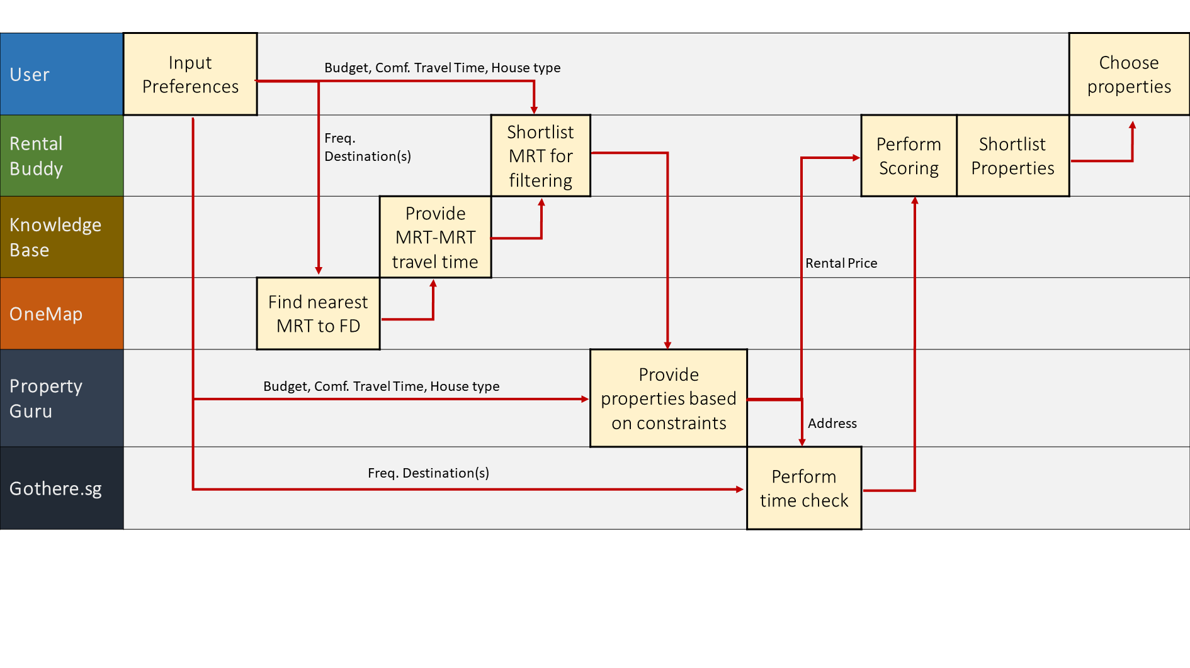
Higher Level Diagram

Slide 3
Higher Level Diagram

Slide 4
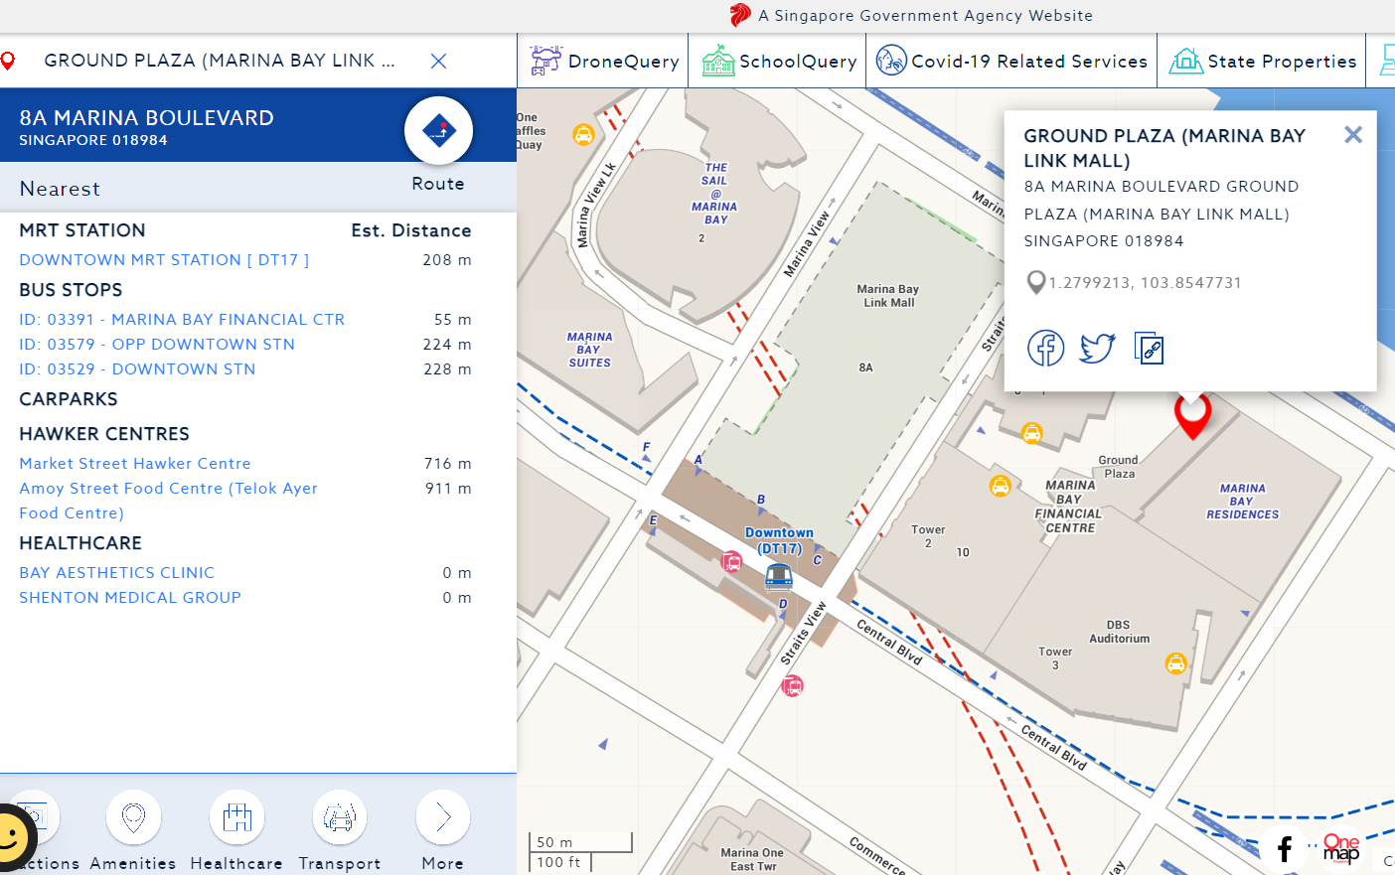
Choosing an MRT for Filtering
Performed by TagUI on OneMap
Shortlisted by a formula
Notes:
Moving Image

Slide 5
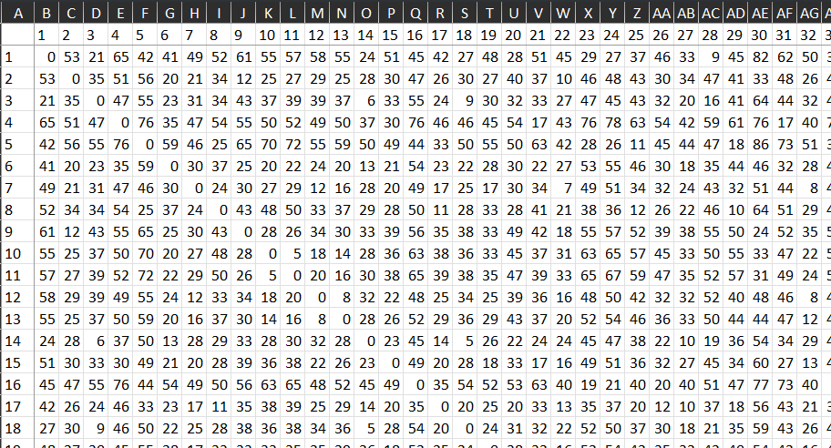
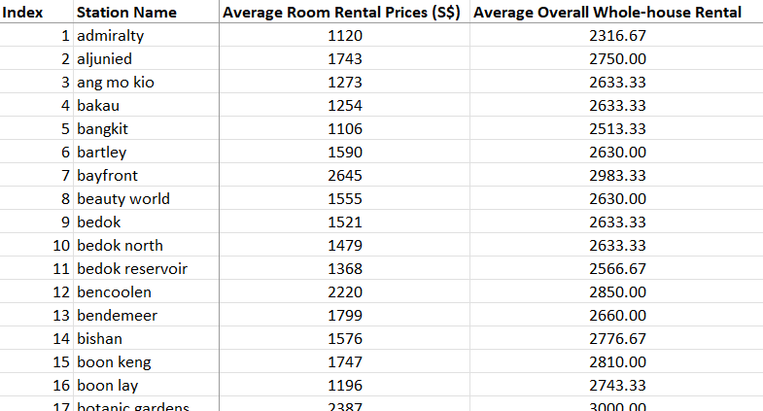
Knowledge Base
MRT-MRT Travel Time Sheet (Indices used as MRT Name)
Average Rental at each MRT
Notes:
Moving Image

Slide 6
Higher Level Diagram

Slide 7
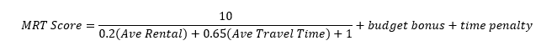
Higher Level Diagram

Slide 8
Higher Level Diagram

Slide 9
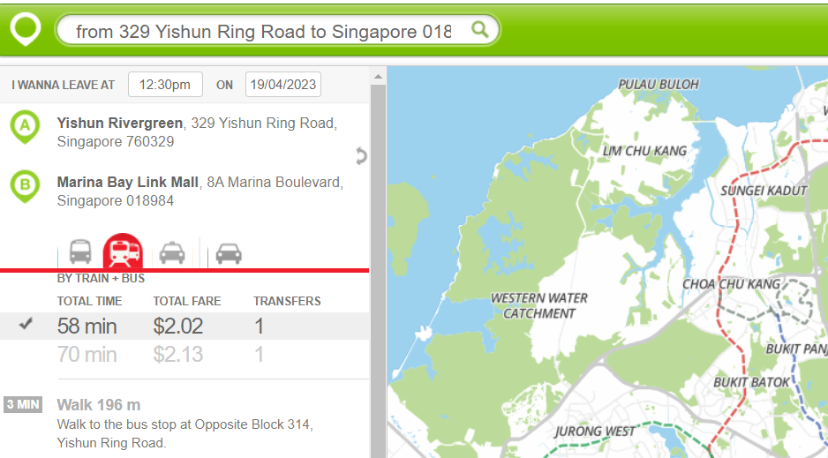
Travel Time-Checking
Notes:
Moving Image

Slide 10
Higher Level Diagram

Slide 11
Higher Level Diagram

Slide 12
Higher Level Diagram

Slide 13
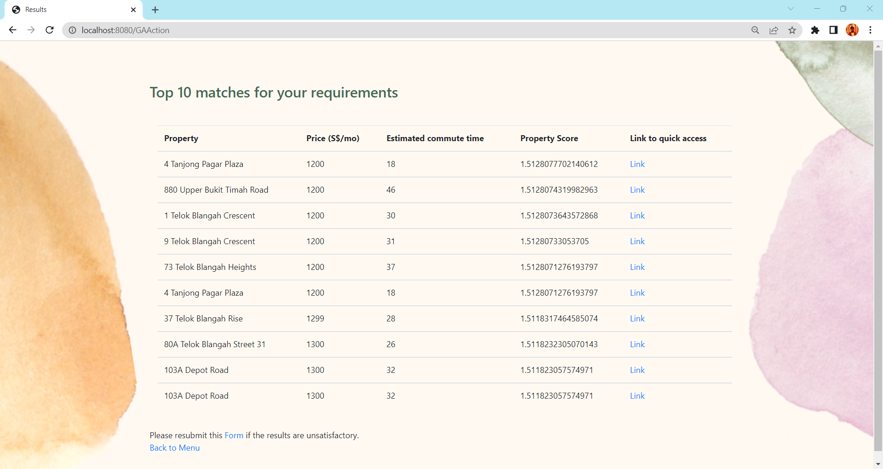
Output to User
Notes:
Moving Image

Slide 14
Optimization – Genetic Algorithm
Notes:
Moving Image

Slide 15
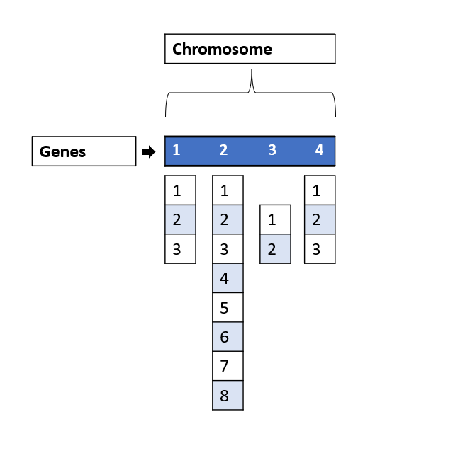
Genes, Chromosomes, and Population
An Individual Has 4 Genes defined as below (Constraints):
Gene 1: 3 Different Filtering methods in Property Guru
Gene 2: 8 Different Sort Methods in Property Guru
Gene 3: 2 Different Scrape Methods in Rent Buddy
Gene 4: 3 Different Time-Check Methods in Rent Buddy
A population of 10 such individuals were initialized
Notes:
Moving Image

Slide 16
Genes, Chromosomes, and Population
An Individual Has 4 Genes defined as below (Constraints):
Gene 1: 3 Different Filtering methods in Property Guru
Gene 2: 8 Different Sort Methods in Property Guru
Gene 3: 2 Different Scrape Methods in Rental Buddy
Gene 4: 3 Different Time-Check Methods in Rental Buddy
A population of 10 such individuals were initialized
Notes:
Moving Image

Slide 17
Genes, Chromosomes, and Population
An Individual Has 4 Genes defined as below (Constraints):
Gene 1: 3 Different Filtering methods in Property Guru
Gene 2: 8 Different Sort Methods in Property Guru
Gene 3: 2 Different Scrape Methods in Rental Buddy
Gene 4: 3 Different Time-Check Methods in Rental Buddy
A population of 10 such individuals were initialized
Notes:
Moving Image

Slide 18
Genes, Chromosomes, and Population
An Individual Has 4 Genes defined as below (Constraints):
Gene 1: 3 Different Filtering methods in Property Guru
Gene 2: 8 Different Sort Methods in Property Guru
Gene 3: 2 Different Scrape Methods in Rental Buddy
Gene 4: 3 Different Time-Check Methods in Rental Buddy
A population of 10 such individuals were initialized
Notes:
Moving Image

Slide 19
Genes, Chromosomes, and Population
An Individual Has 4 Genes defined as below (Constraints):
Gene 1: 3 Different Filtering methods in Property Guru
Gene 2: 8 Different Sort Methods in Property Guru
Gene 3: 2 Different Scrape Methods in Rental Buddy
Gene 4: 3 Different Time-Check Methods in Rental Buddy
A population of 10 such individuals were initialized
Notes:
Moving Image

Slide 20
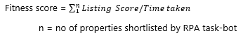
Fitness, Selection, and Evaluation
Fitness Function
Each individual (pipeline) will give a list of 10 properties and their individual score
The fitness score of an individual is calculated by summing up the shortlisted property scores from that pipeline and divided by the time taken for completion of RPA task
Selection and Evaluation
Once a random population of 10 chromosomes (pipelines) were generated, the selection and evaluation of fitness happen amongst them.
The algorithm randomly selects 2 from the 10 and compare their fitness score and only keep the pipeline with higher score.
These steps continue for 5 turns to select 5 pipelines.
These members are the selected members of each generation.
Notes:
Moving Image

Slide 21
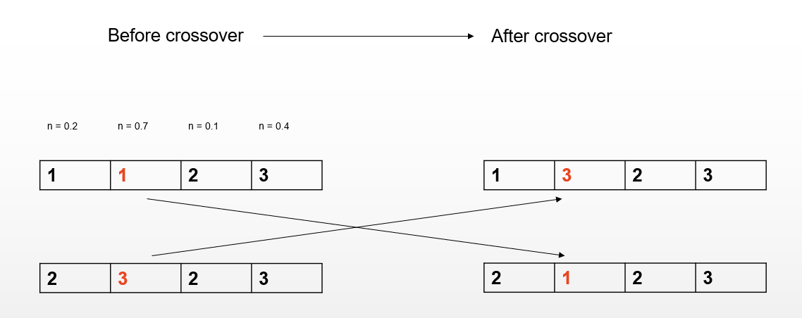
Crossover
Crossover operation on selected members to get new members.
A random number n in the range of (0,1) along with 2 random members which are picked from the selected pool and individual gene components of member 1 will get replaced with that of the gene from member 2 corresponding to the same position given n is greater than 0.5.
The crossover rate is set to 0.5 for introducing diversity of population. This will generate 5 new child members from the selected members.
Notes:
Moving Image

Slide 22
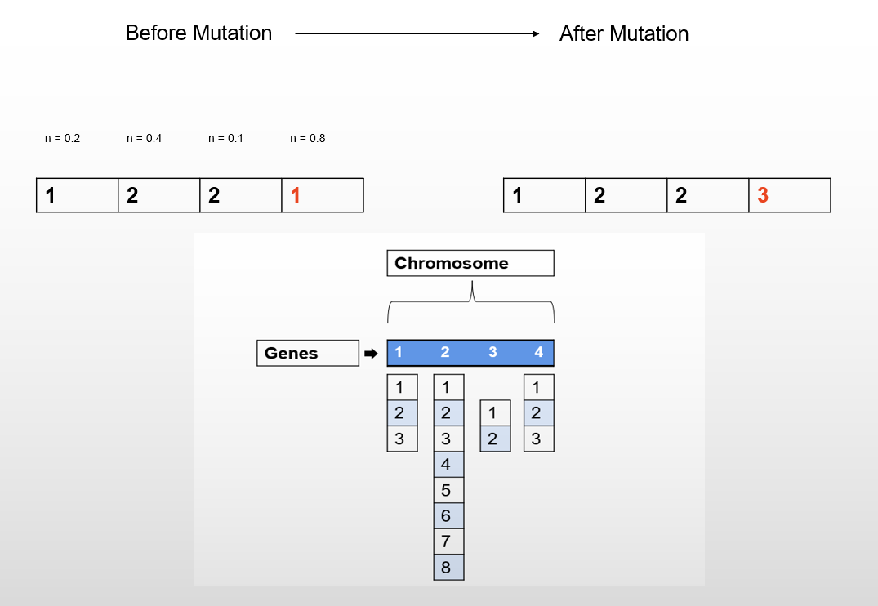
Mutation
Following crossover, we introduced mutation.
For each iteration within each child members generated from crossover, and for 5 turns, a random number n in the range of (0,1) and if n is greater than 0.5, that for current gene (in loop) of current chromosome will get mutated to a different number withing the method constraints we talked about in section 8.3.
Here also the Mutation rate is set to 0.5 for introducing diversity of population. This will generate 5 new child members from the selected members.
Notes:
Moving Image

Slide 23
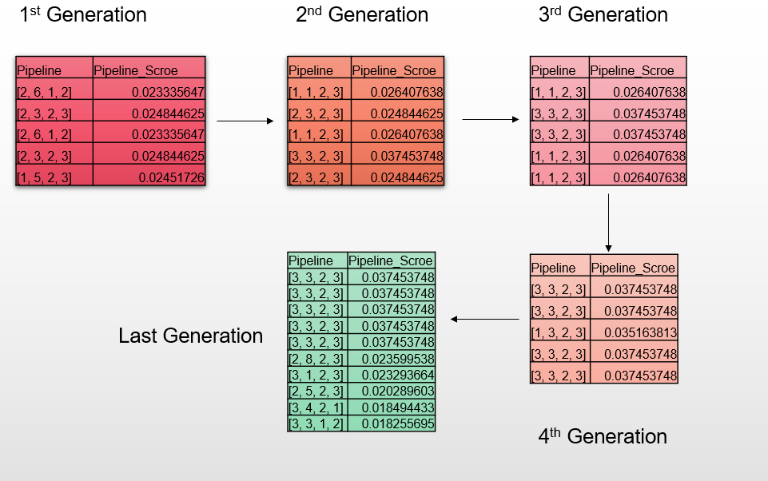
Results
Conclusion
As we can see the algorithm start converging from the 4th generation and picks the pipeline [3,3,2,3] as the best amongst the entirety of population which we have introduced
overall best pipeline was identified with best score which is 0.037453748
Notes:
Moving Image

Slide 24
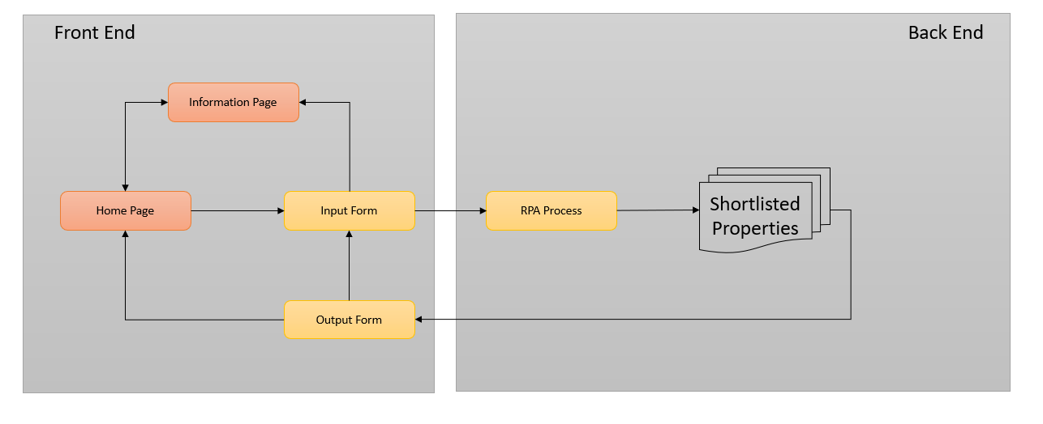
Website Design
Notes:
Moving Image

Slide 25
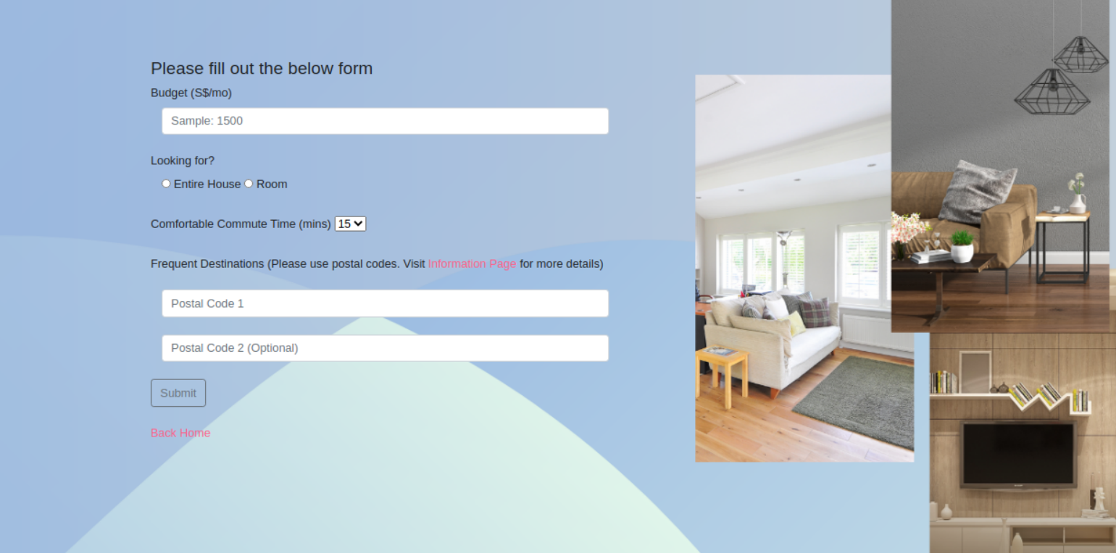
Website Design
Components Needed from the User:
Budget (S$/mo): An integer, e.g.: 1500 which will be considered as SGD 1500/month as your budget
Looking for: The type of property you’re looking for (either just a room / entire house)
Comfortable Commute Time (mins): Your accepted commute time in minutes
Frequent Destinations: Postal codes of 1 or 2 of your Centre of Activities (CoA) in Singapore
Notes:
Moving Image

Slide 26

Website Design
Notes:
Moving Image

Slide 27
Website Design
Notes:
Moving Image

Slide 28
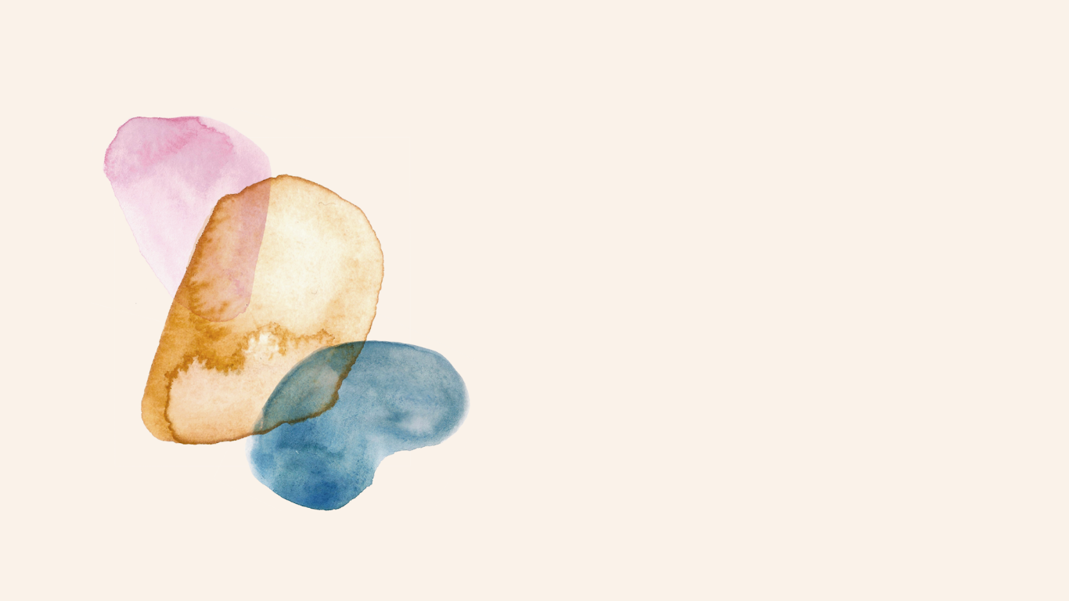
Thank you!
Notes:
Moving Image

